Slide 1

Sarcasm-as-a-Service
@rorypreddy
https://aka.ms/sarcasm

Slide 2

Meet Rory
Not related to Tyrion Lannister
Don’t do kids parties
@rorypreddy

Slide 3
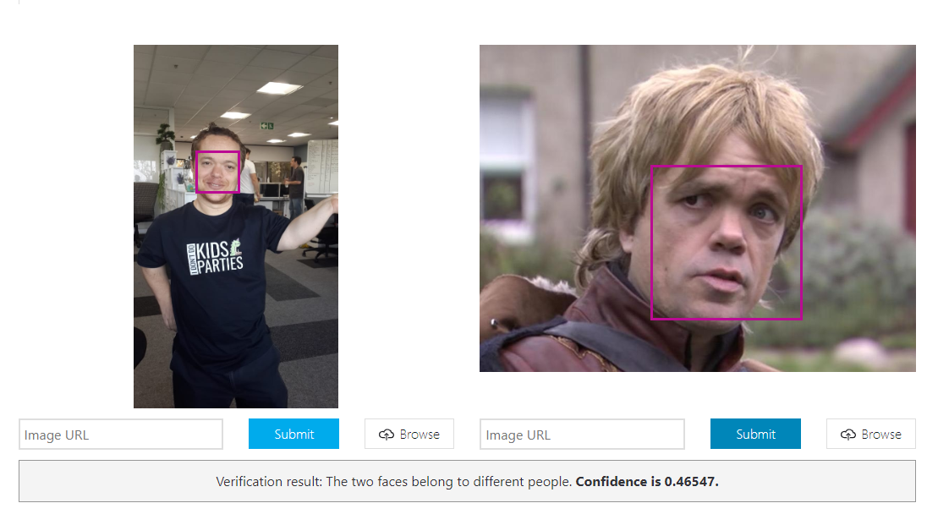

Slide 4
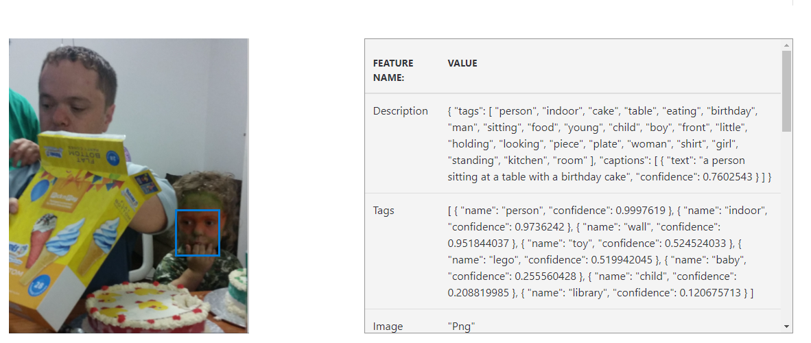

Slide 5
Agenda
Introduction
NLP
Machine learning
Demo
Sarcasm
Conclusion

Slide 6
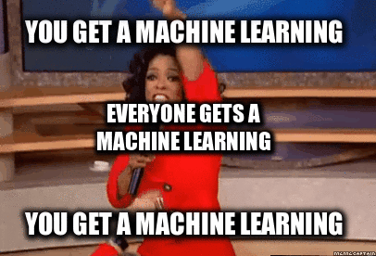

Slide 7


Slide 8
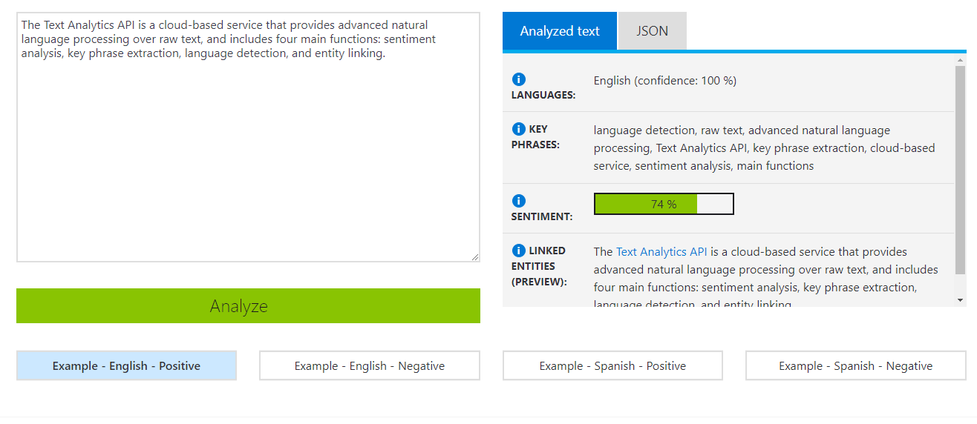

Slide 9


Slide 10


Slide 11
Agenda
Introduction
NLP
Machine learning
Demo
Sarcasm
Conclusion

Slide 12
NLP
The Text Analytics API is a cloud-based service that provides advanced natural language processing over raw text, and includes three main functions: sentiment analysis, key phrase extraction, and language detection.

Slide 13
NLP
Entities
The Text Analytics API is a cloud-based service that provides advanced natural language processing over raw text, and includes three main functions: sentiment analysis, key phrase extraction, and language detection.

Slide 14
NLP
Key phrases
The Text Analytics API is a cloud-based service that provides advanced natural language processing over raw text, and includes three main functions: sentiment analysis, key phrase extraction, and language detection.

Slide 15

Language

Slide 16

Syntax

Slide 17
Sentiment

Slide 18
Calculating sentiment
Machine learning as a service (MLaaS)
Manually
Machine Learning

Slide 19
Manually
-2
My legs ache.
You are the coolest.
I hate Paul but encourage him.
3
-4
2

Slide 20
Manually
2
I am Extremely impressed.
You are the coolest!!
u h8 me? ☹
3
-2

Slide 21
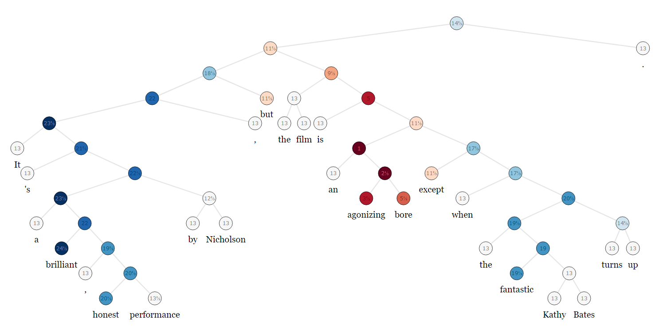
https://nlp.stanford.edu/sentiment/treebank.html

Slide 22
Agenda
Introduction
NLP
Machine learning
Demo
Sarcasm
Conclusion

Slide 23


Slide 24
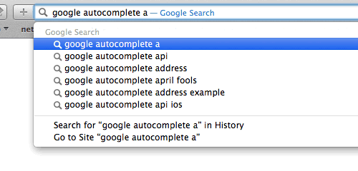

Slide 25


Slide 26
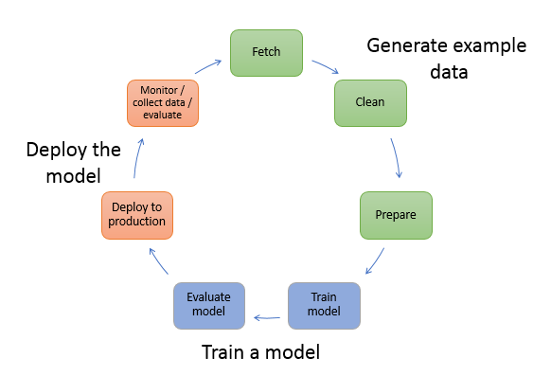
Machine learning

Slide 27
Training set
Labelled observations
1
3
Machine learner
2
3
Test set
4
4
Prediction model
stats
2

Slide 28
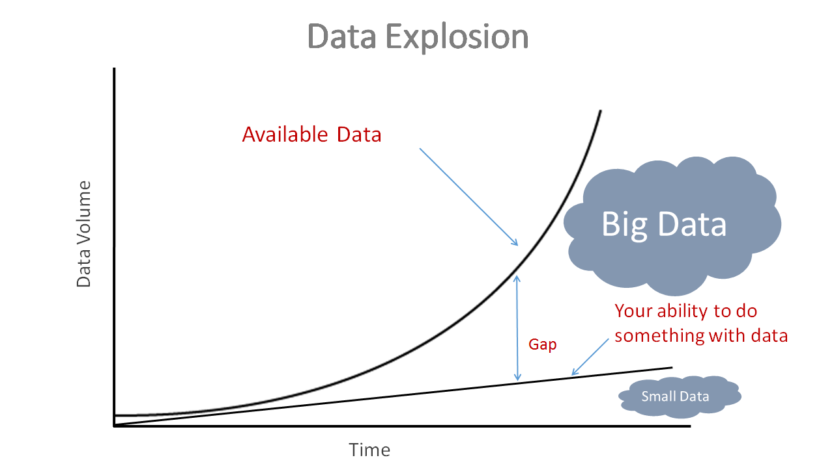

Slide 29
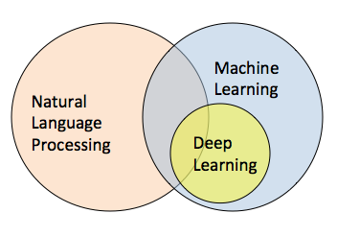

Slide 30
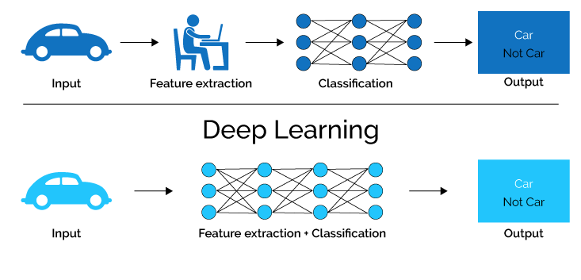
Machine learning
Deep learning

Slide 31

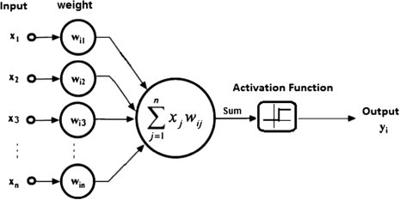
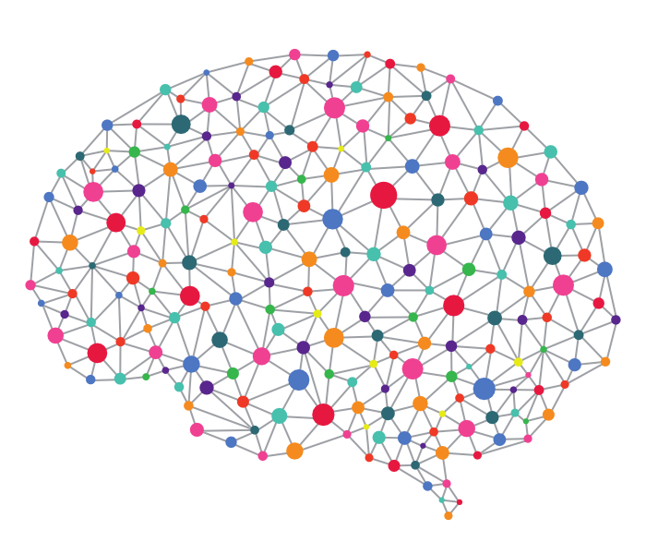
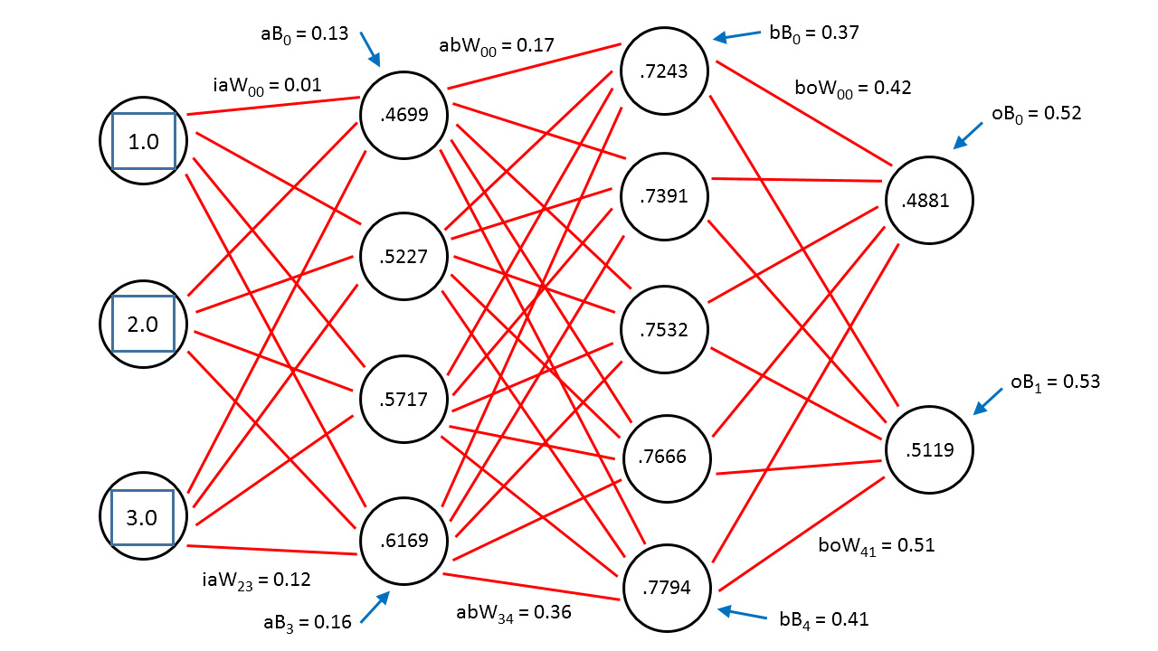
Brain
Artificial Neural Network

Slide 32


Slide 33
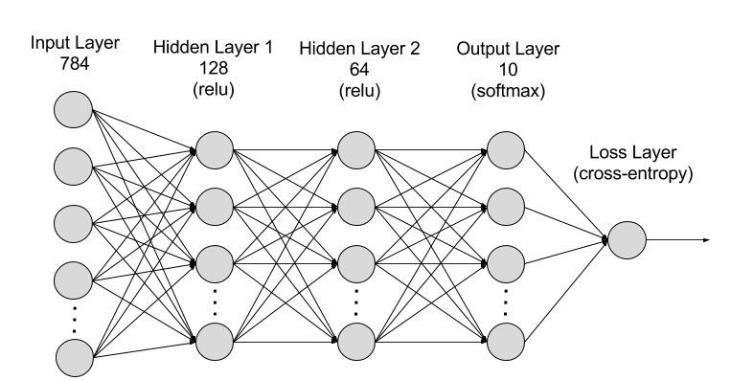
Vector
word
vector
The
Lions
will
win
the
tri
nations
(0.12,0.23,0.56)
(0.24,0.65,0.72)
(0.38,0.42,0.12)
(0.57,0.01,0.02)
(0.53,0.68,0.91)
(0.11,0.27,0.45)
(0.01,0.05,0.62)
Markov Chains

Slide 34

Image is represented as matrix of numbers

Slide 35

Vector

Slide 36
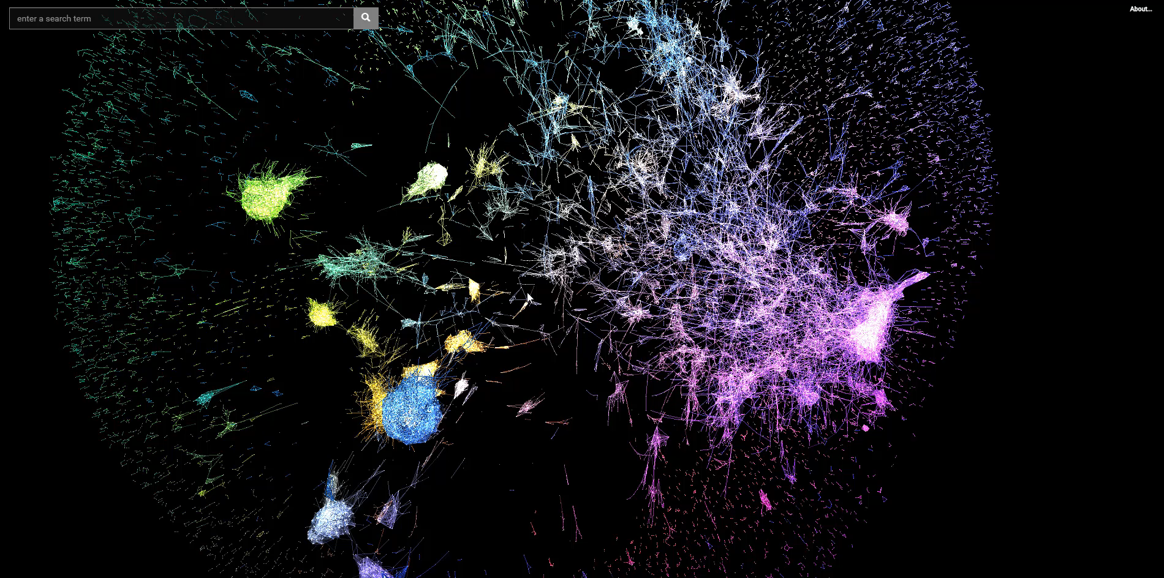
https://github.com/anvaka/word2vec-graph
Notes:
https://anvaka.github.io/pm/#/galaxy/word2vec-wiki?cx=-4651&cy=4492&cz=-1988&lx=-0.0915&ly=-0.9746&lz=-0.2030&lw=0.0237&ml=300&s=1.75&l=1&v=d50_clean_small

Slide 37
Documents classes
Softmax
Hidden linear layer
Averaging
Documents vector
Word vector x₁
Word vector x₂
Word vector x_{n}
Document

Slide 38


Slide 39
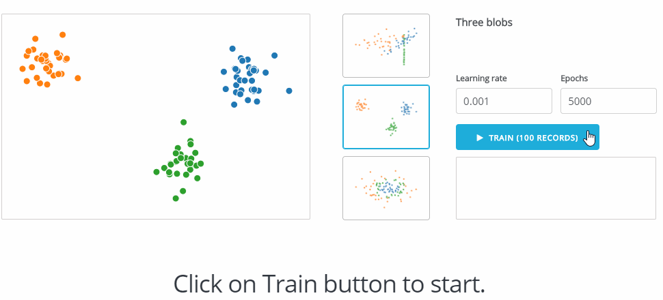
https://juggernaut.rs/demo/

Slide 40
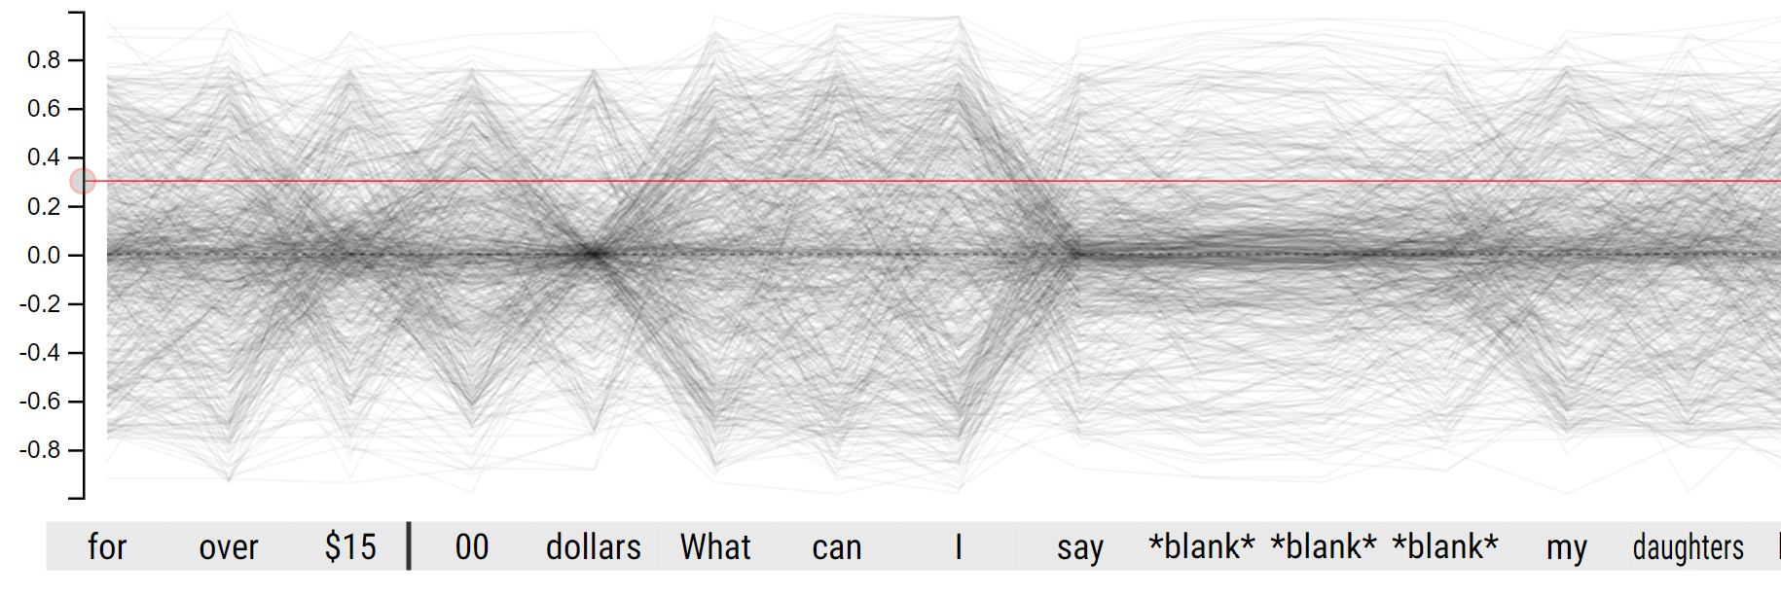
http://lstm.seas.harvard.edu

Slide 41
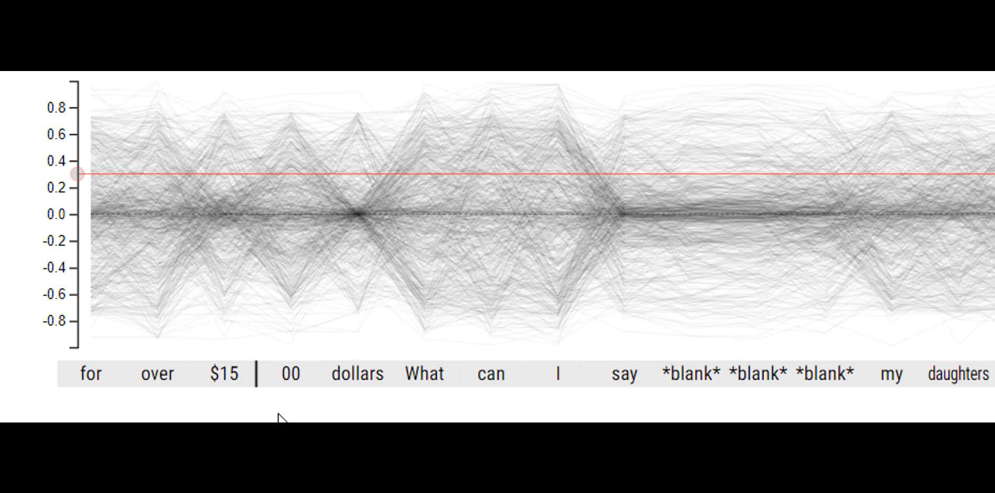
http://lstm.seas.harvard.edu

Slide 42

https://aka.ms/sarcasm

Slide 43
Agenda
Introduction
NLP
Machine learning
Sarcasm
Detecting Sarcasm
Demo
Conclusion

Slide 44

Irony

Slide 45


Slide 46


Slide 47
Sarcasm
Greek: ‘sarkasmós’: ‘to tear flesh with teeth’
Sanskrit: ‘vakrokti’: ‘a twisted (vakra)
utterance (ukti)’
Sarcasm
a negative form of rhetoric in which neutral or pleasant sounding words are used to make harsh criticisms.

Slide 48


Slide 49


Slide 50
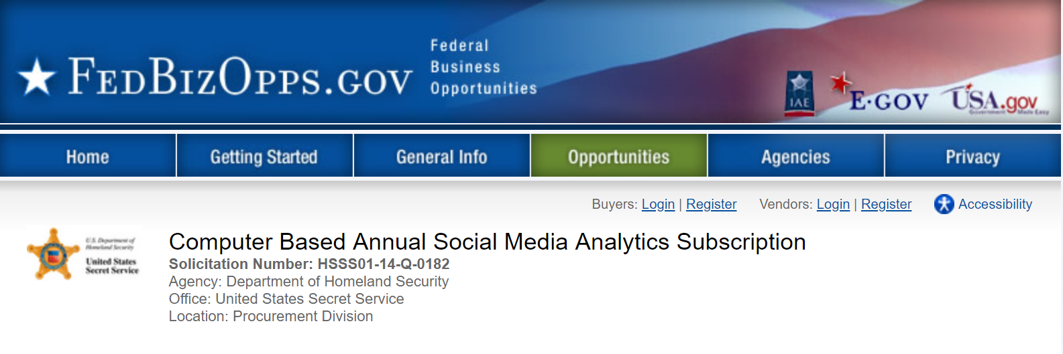

Slide 51


Slide 52
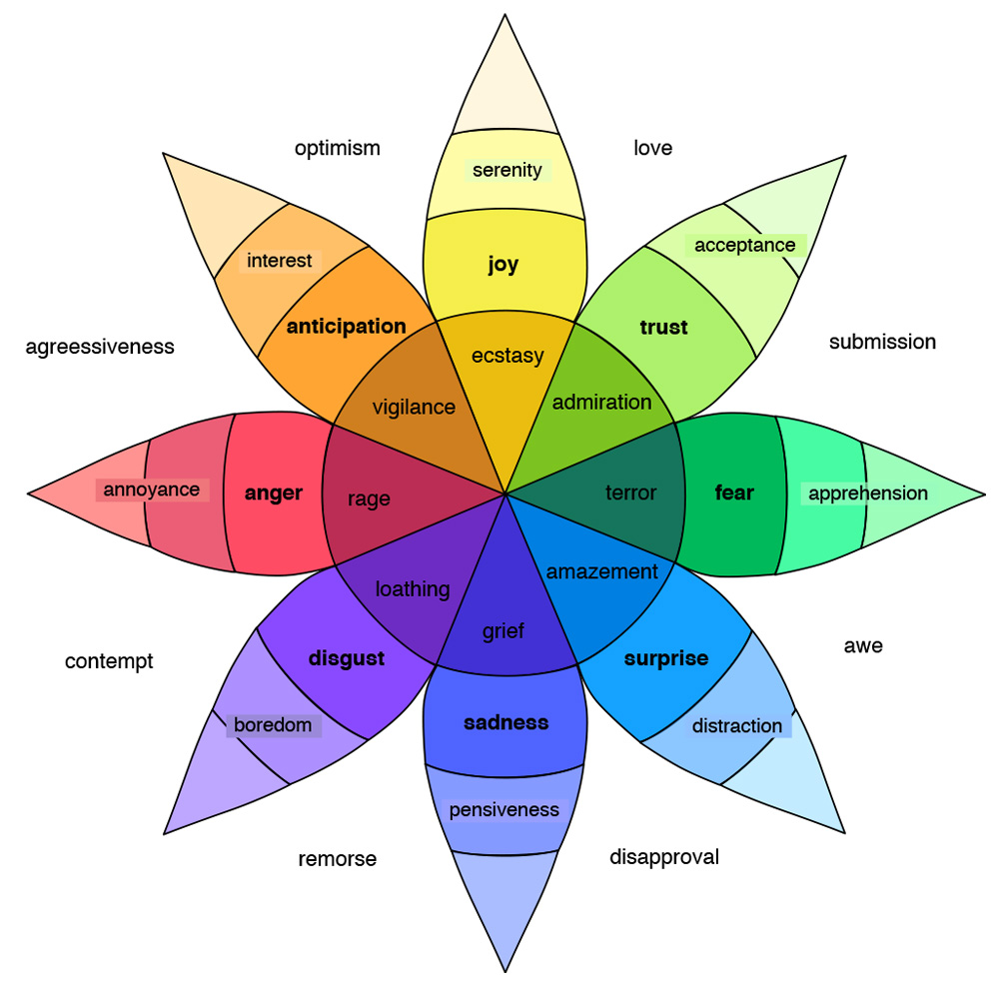

Slide 53

Artificial emotional intelligence

Slide 54
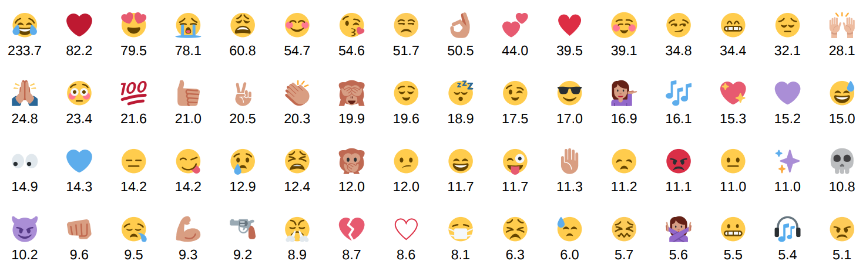
Training each emoji in millions
55 Billion → 1.6 Billion

Slide 55
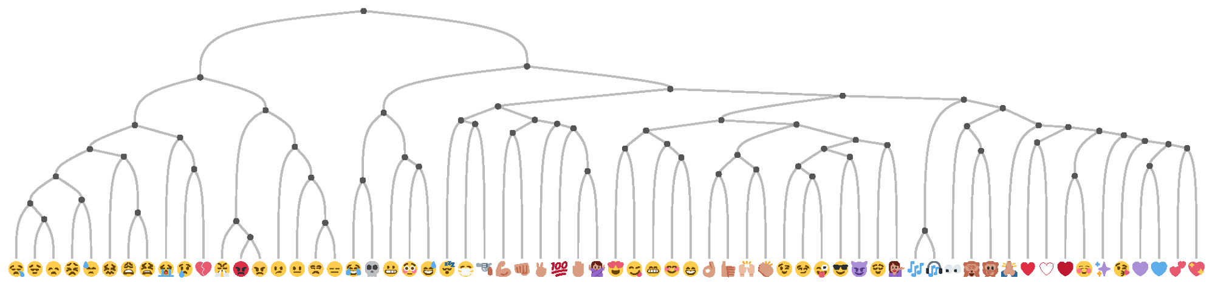

Slide 57
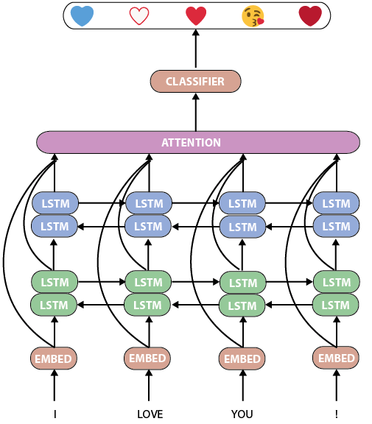

Slide 58
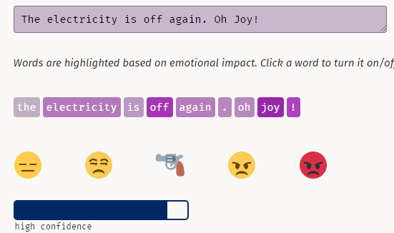

Slide 59
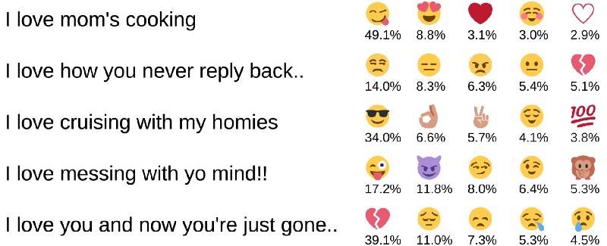
http://deepmoji.mit.edu

Slide 60

http://seeingai.com

Slide 61
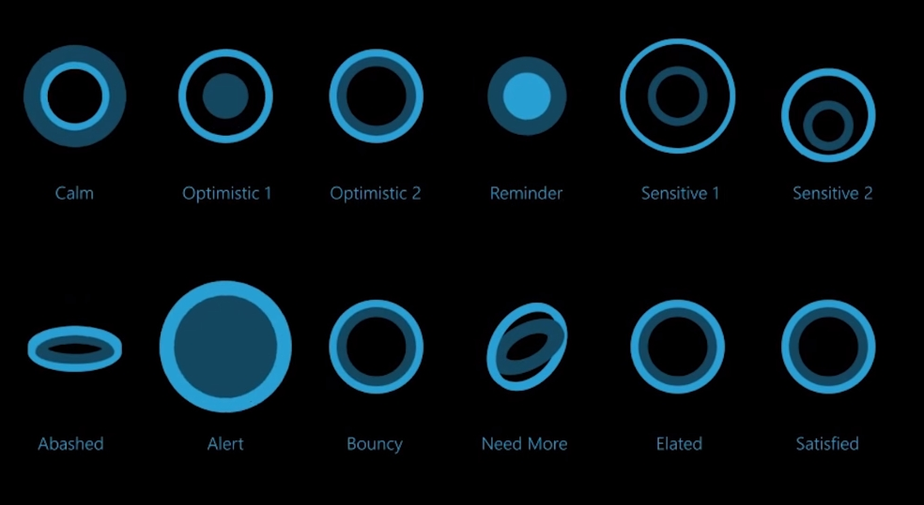
Cortana emotions

Slide 62

Conclusion

Slide 63
Thank you
@rorypreddy
https://aka.ms/sarcasm

